Slide 1


CS209:Artificial Intelligence
Course Project : Predicting Student Depression
Submitted by:
Surya Prakash S CS23BT068
P Sri Smaran CS23BT039
Rahul Rathlavath CS23BT018
Banoth Pavan Kumar CS23BT024
Course Instructor: Prof. Dileep. A.D
Mentor Name:Mrs. Anupama P Bidargaddi

Slide 2
Outline
Date:05/05/2025
Introduction
Methodology
Results
Conclusion
2

Slide 3
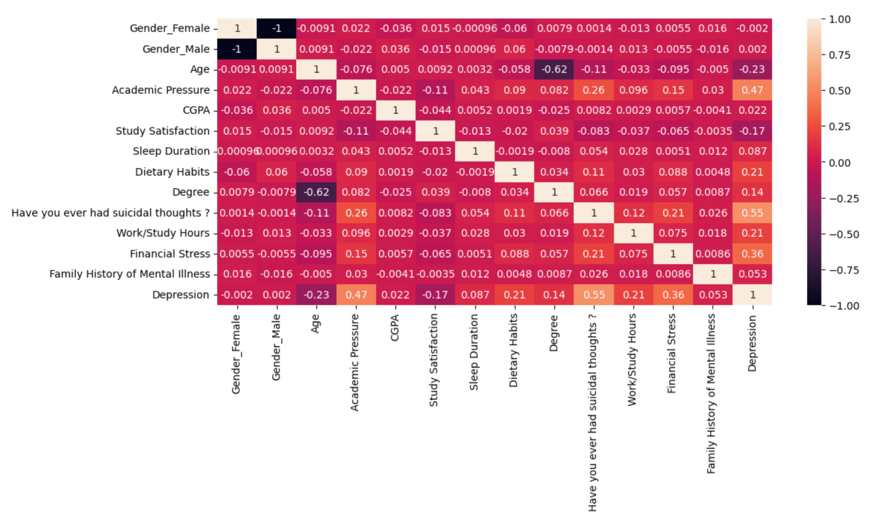
Date:05/05/2025
Introduction
This project aims to predict student depression using a variety of machine learning models. We are given different attributes with different types of functionality.
Key Features Used in the Model
Target Variable: Depression
Gender
Age
City
Academic Pressure
CGPA
Study Satisfaction
Sleep Duration
Dietary Habits
Degree
Suicidal Thoughts
Study Hours
History of Mental Illness
Correlation Matrix
3

Slide 4
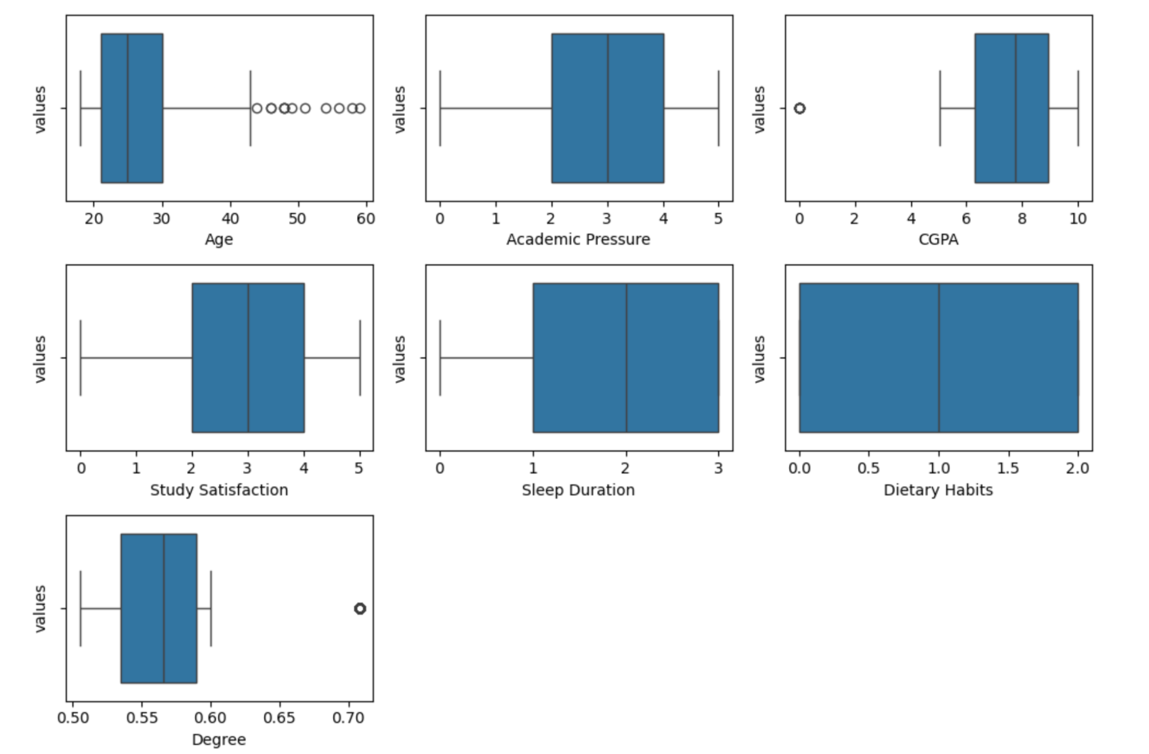
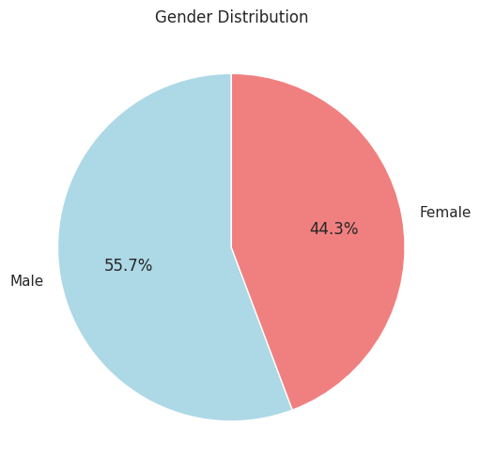
Date:05/05/2025
Data Exploration
Box plots for non encoded columns
Gender Distribution
4

Slide 5
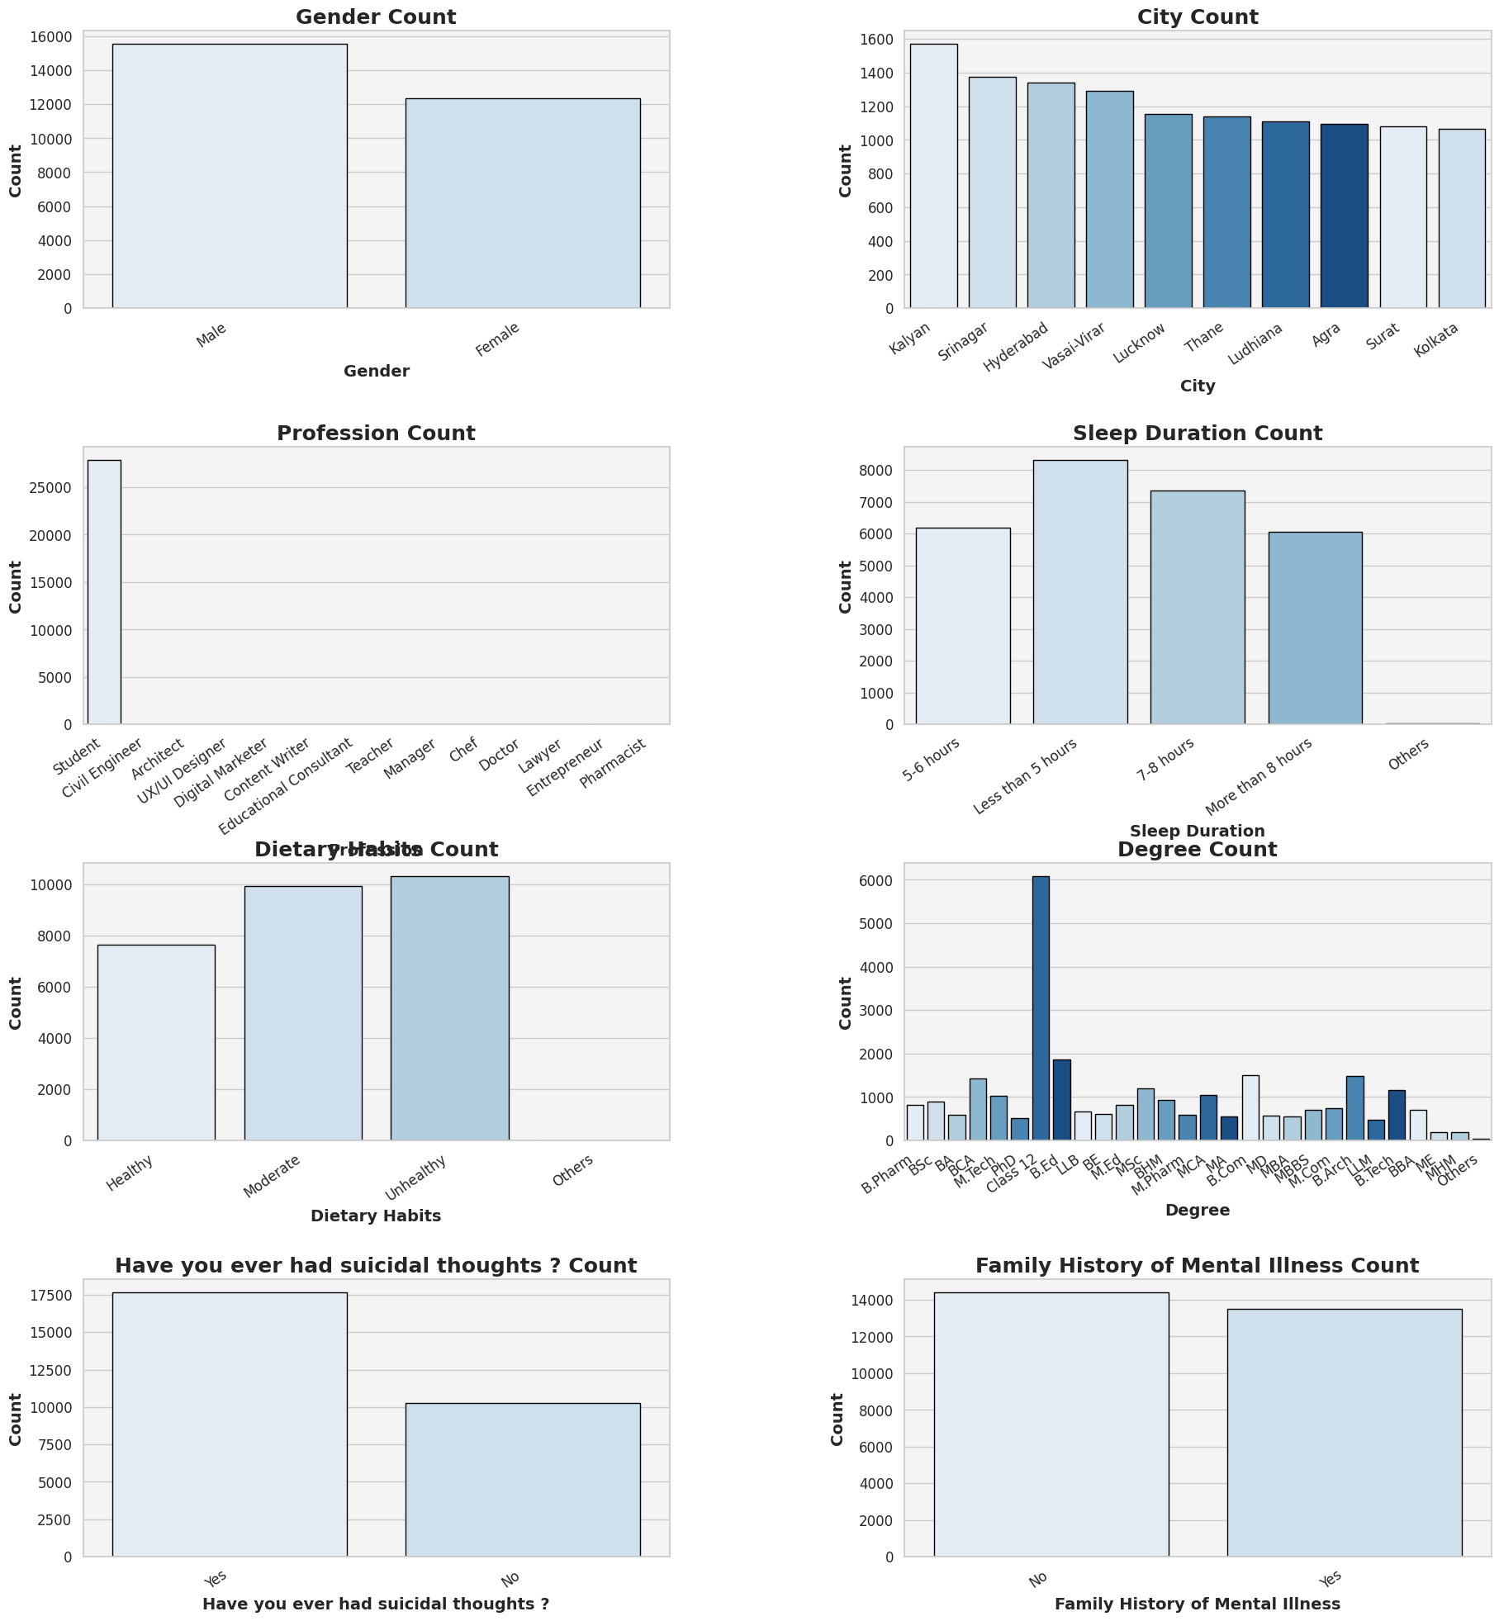
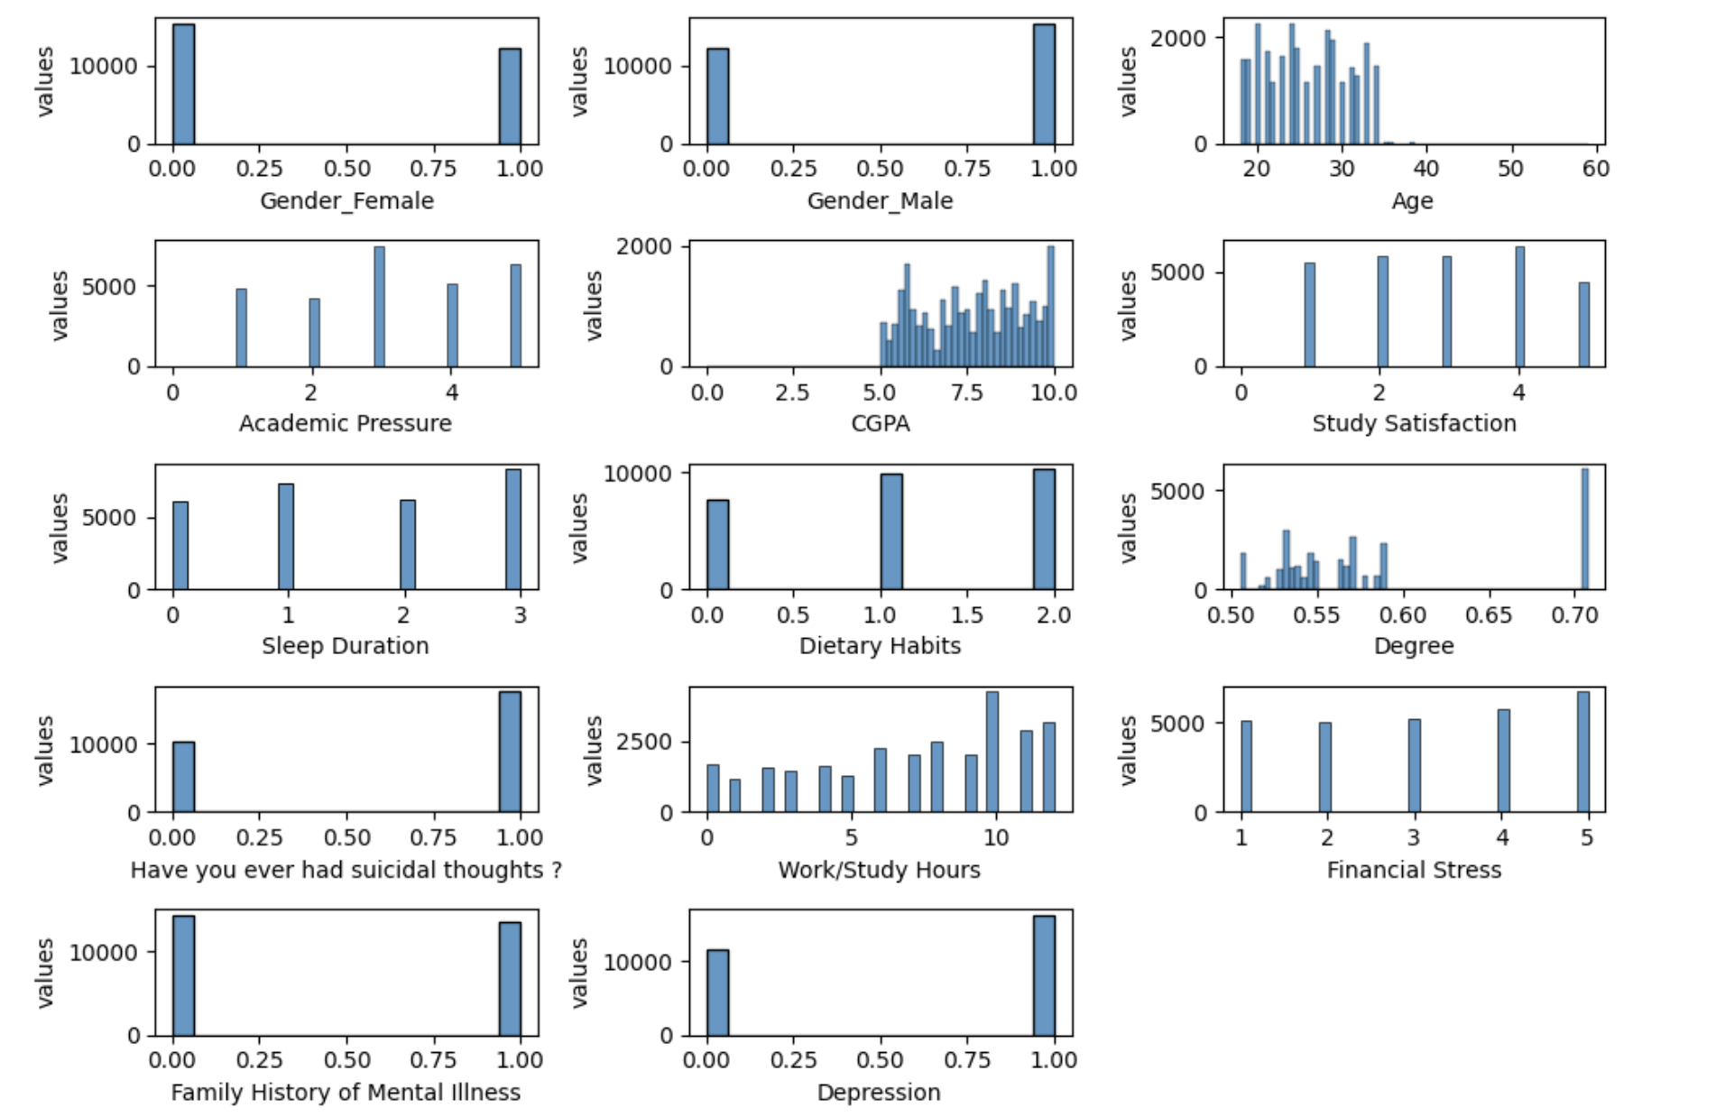
Date:05/05/2025
Data Exploration
Distribution of categorical variable
Distribution of all columns

Slide 6
Date:05/05/2025
Methodology
Pipeline Overview:
• We designed a modular pipeline to streamline the preprocessing, feature selection, and classification tasks.
• The pipeline integrates custom data cleaning, transformation, model fitting, and evaluation stages.
Custom Cleaner:
• A custom transformer was implemented using sklearn’s BaseEstimator and TransformerMixin.
• It handles missing value imputation, data normalization, encoding categorical variables, and miscellaneous cleaning logic.
Pipeline Usage:
• Each model was trained and evaluated using a version of the pipeline according to its requirements.
• This ensures consistency across different classification methods

Slide 7
Date:05/05/2025
Preprocessing Steps
• Handling Missing Values: Median imputation (didn’t find any missing values)
• Feature Engineering:
Removed redundant features (Profession, Job Satisfaction, Work Pressure, Financial Stress)
Focused on student-specific data (27k samples and 30 anomalies)
• Categorical Encoding:
One-Hot: Gender (nominal)
Ordinal: Dietary Habits, Sleep Duration, Suicidal Thoughts
Target: City, Degree
• Train-Test Split with 5-fold Cross-Validation
Normalization:To normalize numerical features, we applied Z-score normalization using sklearn’s StandardScaler()
Handling outliers: Removed all rows which were not ‘Student’ and dropped the Profession column. Numerical outliers were ignored as they were small in number(10-15 in a 27000+ records dataset). Also ID column was removed.

Slide 8
Date:05/05/2025
Model Evaluation and Explainability
Cross-Validation:
• 5-fold cross-validation was used to estimate generalization performance.
• The dataset was split into 5 parts; each fold was used once as a validation set.
Bayesian Optimization:
• Used for hyperparameter tuning by building a probabilistic model of the objective function.
• Faster and more efficient than grid search with comparable performance.
SHAP for Explainability:
• SHAP (SHapley Additive exPlanations) provides local interpretability.
• Explains the contribution of each feature to individual predictions.

Slide 9
Causal Analysis
Causal discovery is the process of identifying cause-and-effect relationships between variables from data rather than just correlations.
Most machine learning models are great at finding correlations, but correlation ≠ causation. Causal discovery tries to answer deeper questions like:
Does academic pressure cause depression?
If I improve sleep duration, will it reduce depression risk?
Causal discovery aims to uncover the causal structure of a system — often visualized using causal graphs (like Directed Acyclic Graphs or DAGs), where nodes are variables and arrows represent direct causal effects.
PC Algorithm for Causal Discovery
The PC algorithm is a constraint-based method for inferring causal structures from observational data.
It operates by testing conditional independencies among variables to construct a partially directed acyclic
graph (PDAG).
Once the causal graph is established, the causal effect of a treatment T on an outcome Y is estimated. This was facilitated by the Do Why python library.

Slide 10
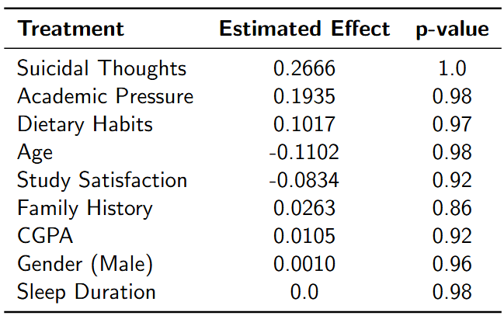
Date:05/05/2025
Causal Effects on Depression
The Average Treatment Effect (ATE) is a key measure in causal inference, representing the average difference
in outcomes if everyone in a population received a treatment versus if no one did.
o assess the robustness of the estimated effects, refutation tests are conducted:
- Random Common Cause: Introduces a random variable as a confounder to check if the estimated effect
changes significantly.
- Placebo Treatment: Replaces the treatment with a placebo (random variable) to ensure that the estimated
effect is zero, validating the model’s integrity.
High p-values (> 0.05) in these tests indicate that the estimates are robust
Key Findings: Suicidal thoughts, academic pressure, and diet have the strongest causal impact.

Slide 11
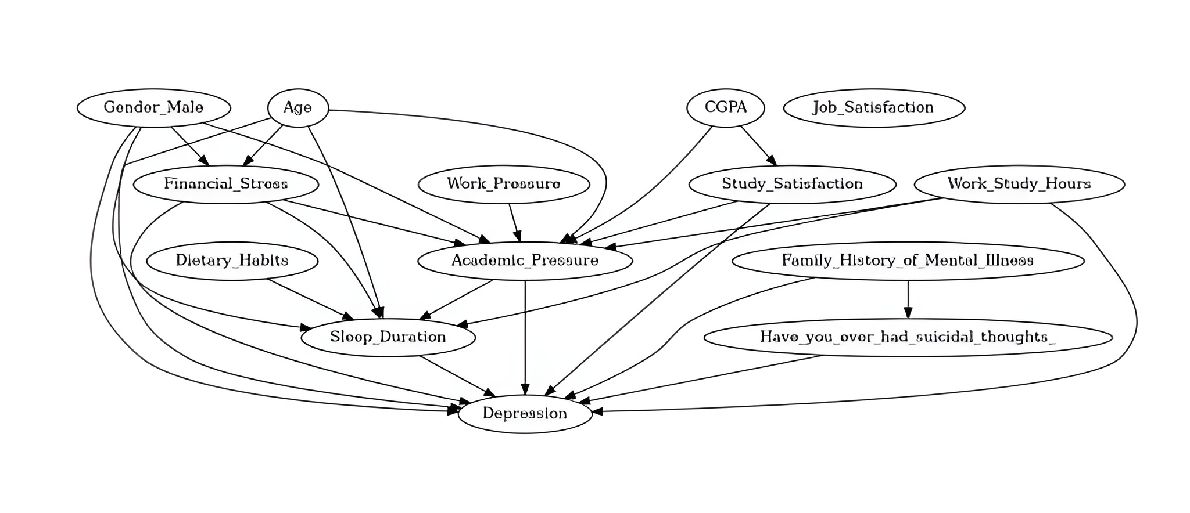
Date:05/05/2025
Causal Graph

Slide 12
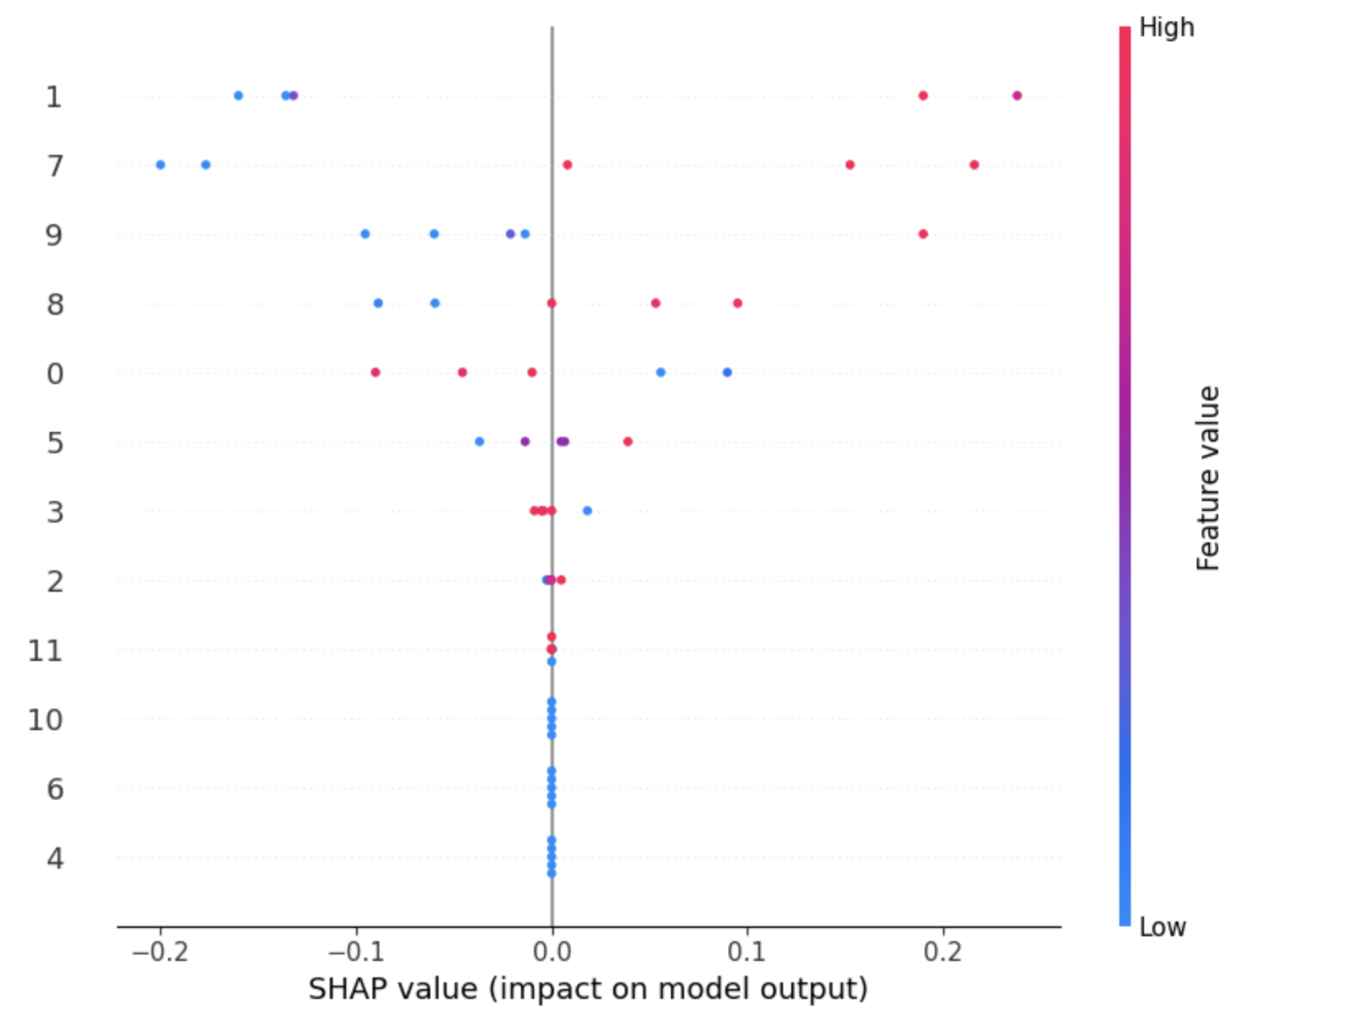
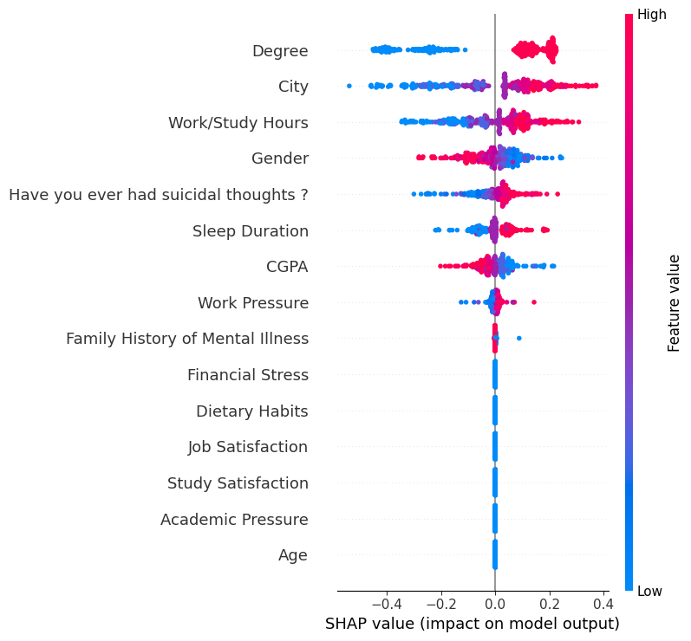
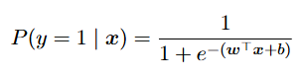
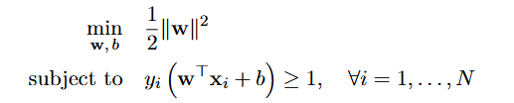
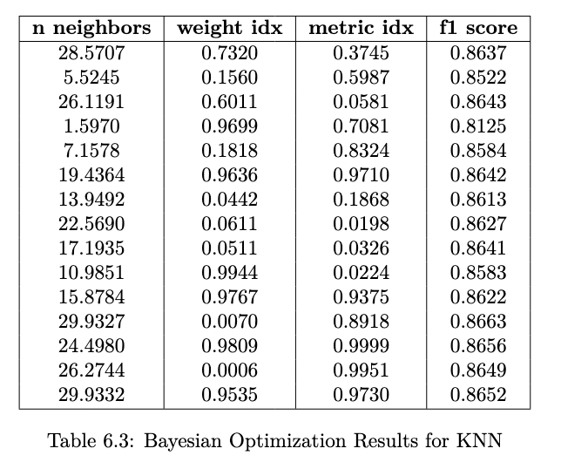
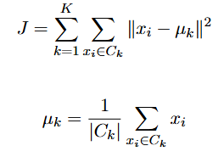
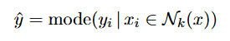
Date:05/05/2025
Models Implemented
The following are the known models and here are the F1-scores for the best models in each method.
Logistic Regression
SVM (rbf)
Best Model F1-score : 87.01
Best Model F1-score : 85.72
Clustering
KNN
DBSCAN :
Best Model F1-score : 78.66
Kmeans:
Best Model F1-score: 43.56
Medoid :
Best Model F1-score : 86.63

Slide 13
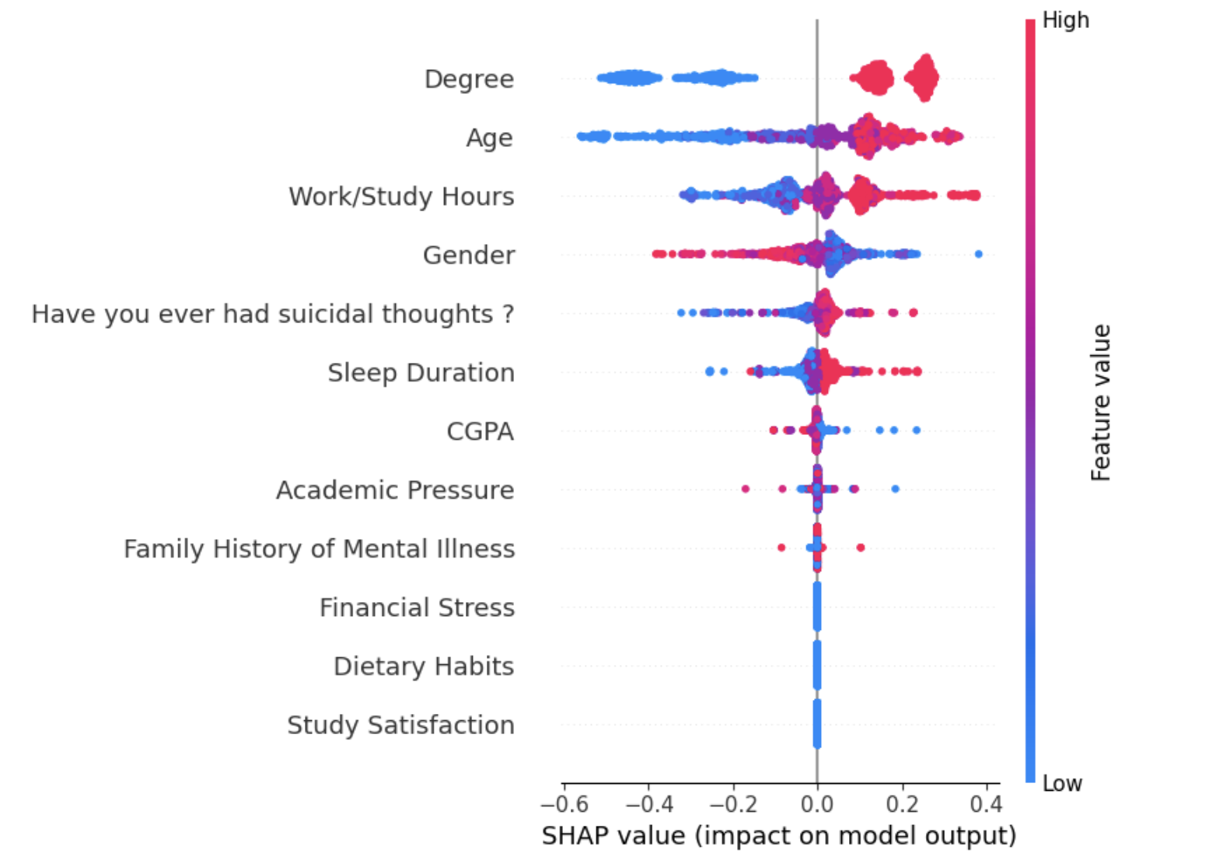
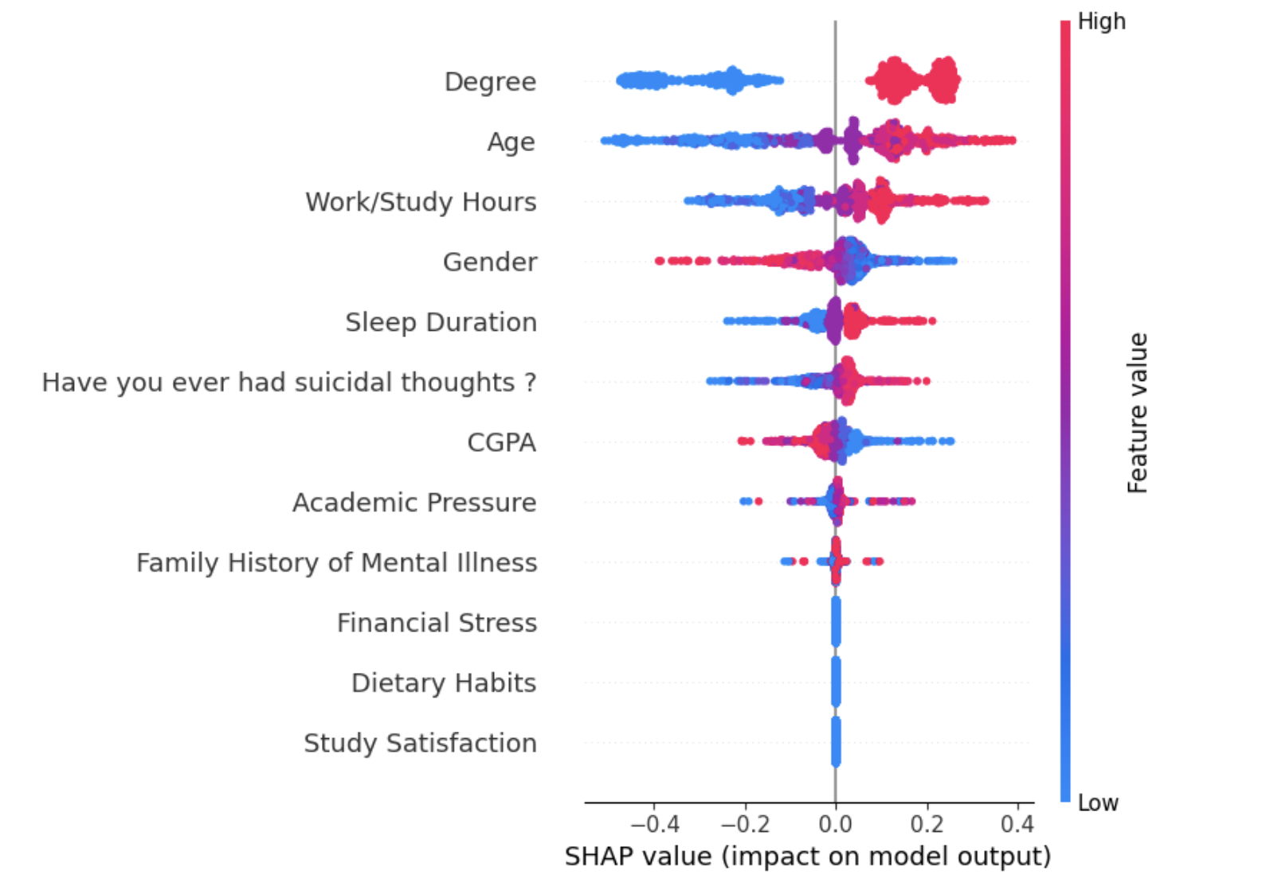
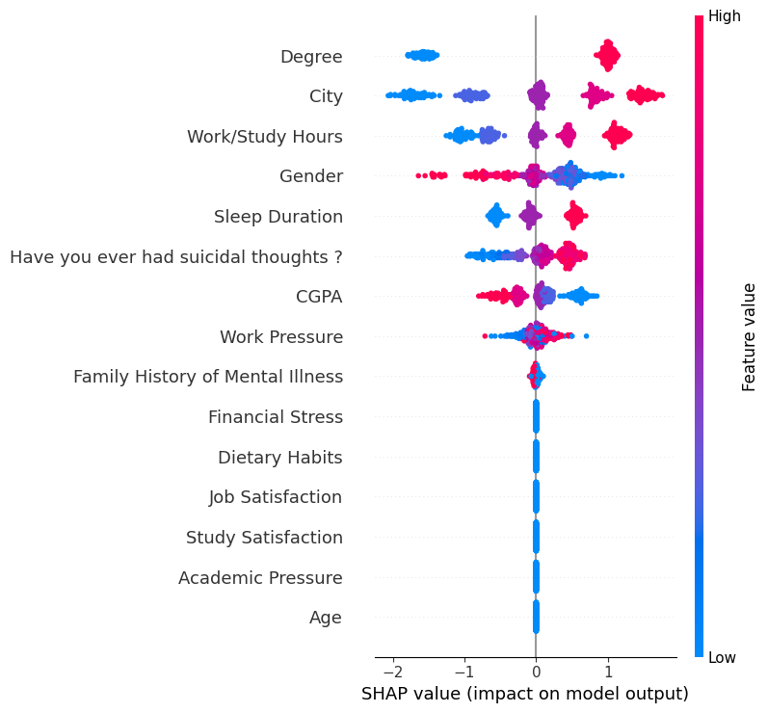
Date:05/05/2025
Tree Based Models
Decision Trees: Recursively splits data based on feature values to maximize information gain.
Working: Recursively splits data based on feature values to maximize information gain.
Best F1 score(on train) = 0.8572
Random Forest: Ensemble of decision trees
using Bagging.
Working:
Trains multiple trees on bootstrap samples
Each tree uses a random subset of features
Aggregates predictions via majority voting
Best F1 score(on train) ≈ 0.8681
XGBoost: Boosted ensemble of trees
Features:
Regularization (to control overfitting)
Parallel tree construction
Column subsampling
Best F1 score(on train) ≈ 0.8713
Respective SHAP values

Slide 14
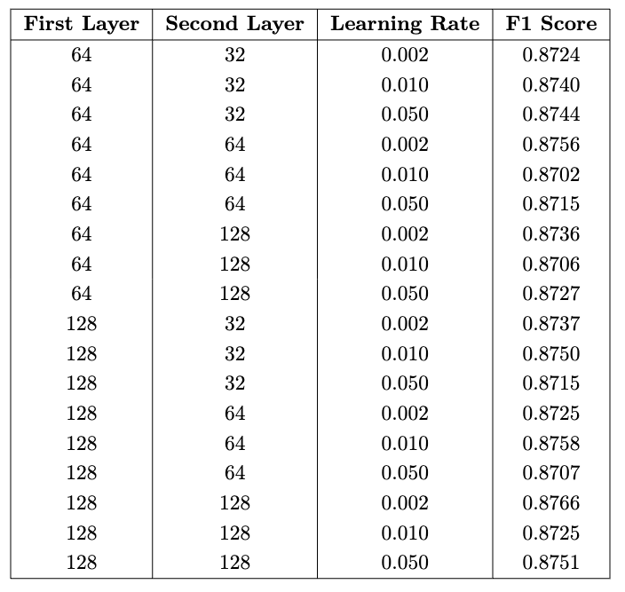
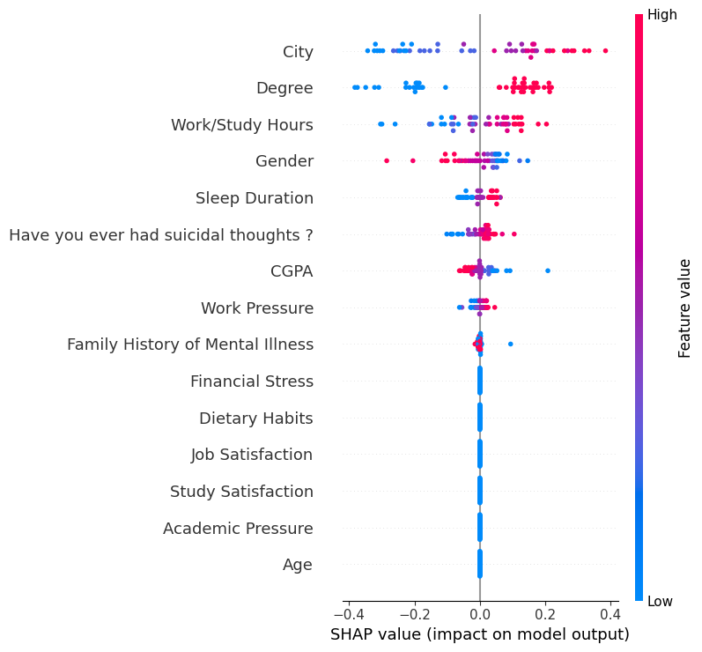
Date:05/05/2025
Neural Networks(FFNN)
Implemented using MLPClassifier from scikit-learn.
Consists of fully connected layers where each neuron applies a weighted sum of inputs followed by a nonlinear activation (e.g., ReLU, tanh).
Trained using backpropagation and SGD-based optimizers to minimize error.
We are using 2 Layer Neural network with a sigmoid function at output of each layer
Hyperparameters Tuned:
Hidden Layer Sizes: e.g., (64, 32), (128, 64), etc.
Learning Rate: e.g., 0.002, 0.01, 0.05
Max Iterations (Epochs): Controls training duration
Evaluation:
Models assessed using F1-score.
Best models validated on unseen data.
F1 Scores of Ann with different architecture
Best model performance:
We got the best F1–score : 87.05
for architecture of d1 = 128, d2 32,lr=0.02
Shap values

Slide 15
Date:05/05/2025
Advanced Ensemble Methods
Model Ensembling
Combines predictions from multiple models to produce a more robust and accurate final output.
Implemented using VotingClassifier from scikit-learn.
Ensembling Strategies:
🔹 Hard Voting: Predicts the class with the majority vote among all models.
🔹 Soft Voting: Averages predicted probabilities and selects the class with the highest average.
Base Models Used:
Logistic Regression
TabNet
LGBM
Goal: Boost overall classification performance for predicting student depression by leveraging diverse model strengths.
Random Forest
XGBoost
KNN
Neural Network (MLP)

Slide 16
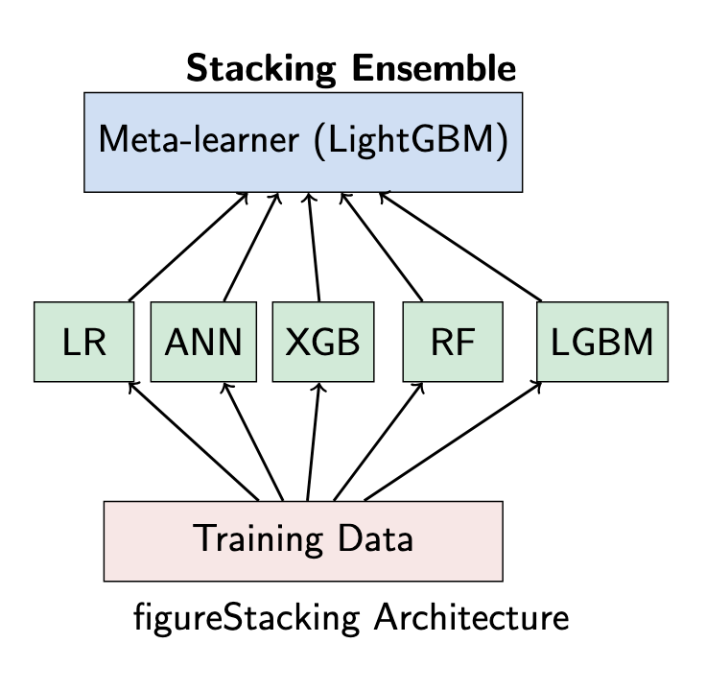
Date:05/05/2025
Model Stacking (Stacked Generalization)
Stacking is an ensemble learning technique that combines multiple models (base learners) using a meta-model.
Unlike voting, stacking learns how to best combine model outputs.
How we implemented:
Base Models (Level-0): Multiple diverse models : Logistic Regression ,Random Forest , XGBoost, ANN and LGBM are trained on the dataset.
Meta-Model (Level-1): A separate model is trained on the predictions of base models to make the final decision. Here our Meta model is LGBM
Advantages:
Learns complex relationships between model outputs.
Often yields better performance than individual models or simple voting.
Performance: F1-score: 87.44

Slide 17
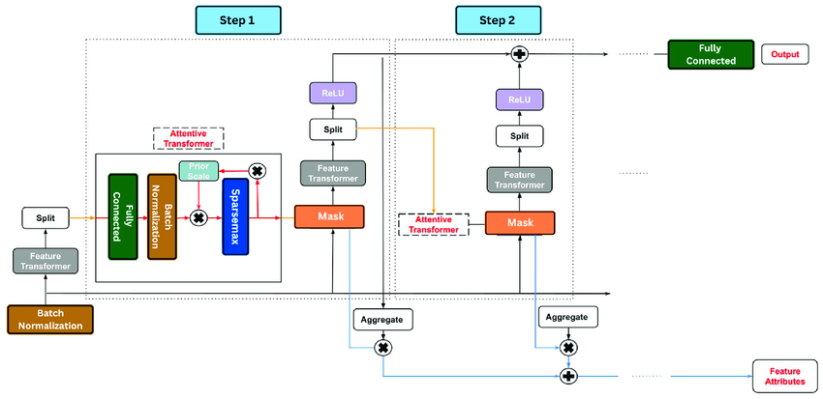
TabNet Classifier
TabNet is a deep learning model designed specifically for tabular data.
It blends the interpretability of decision trees with the representational power of deep learning.
Uses a sequential attention mechanism to select important features at each decision step.
Key Hyperparameters:
n_d, n_a: Dimensions for decision and attention steps.
n_steps: Number of sequential decision steps.
gamma: Controls how much features are reused between steps.
lambda_sparsity: Encourages sparse, focused feature usage.
learning_rate: Affects convergence speed.
mask_type: ('sparsemax' / 'entmax') determines attention sparsity.
Our Implementation:
Hyperparameters tuned via cross-validation.
Achieved competitive results compared to XGBoost and Neural Networks.

Slide 18
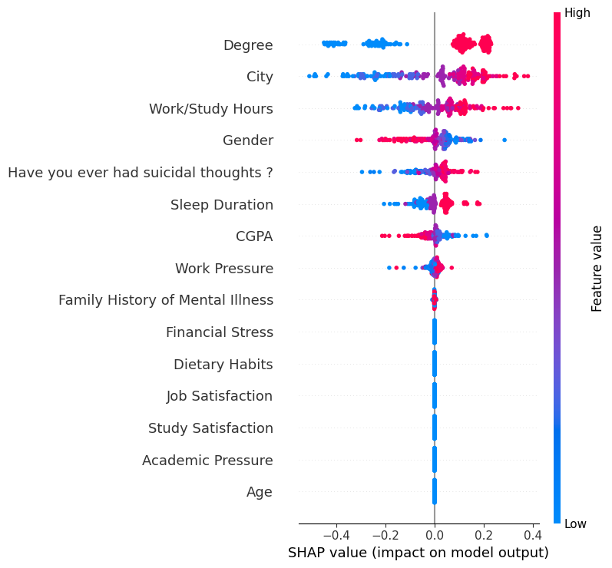
AutoML using FLAML
FLAML (Fast Lightweight AutoML) is an efficient and resource-conscious Python library for automated machine learning.
It automatically selects and tunes models with minimal computation cost.
Models Used in FLAML:
LGBM – Light Gradient Boosting Machine
RF – Random Forest
Extra Trees – Extremely Randomized Trees
FLAML optimizes these models for F1-score using a time-aware search strategy.
LGBM Estimator (LightGBM Classifier)
A high-performance, tree-based gradient boosting framework.
Well-suited for large datasets due to its speed and scalability.
FLAML handles:
Hyperparameter tuning: learning rate, max depth, regularization, etc.
Early stopping: to prevent overfitting.
F1-score optimization: via cross-validation.
Combined, FLAML + LGBM provides robust results with minimal manual tuning.
Shap Values

Slide 19
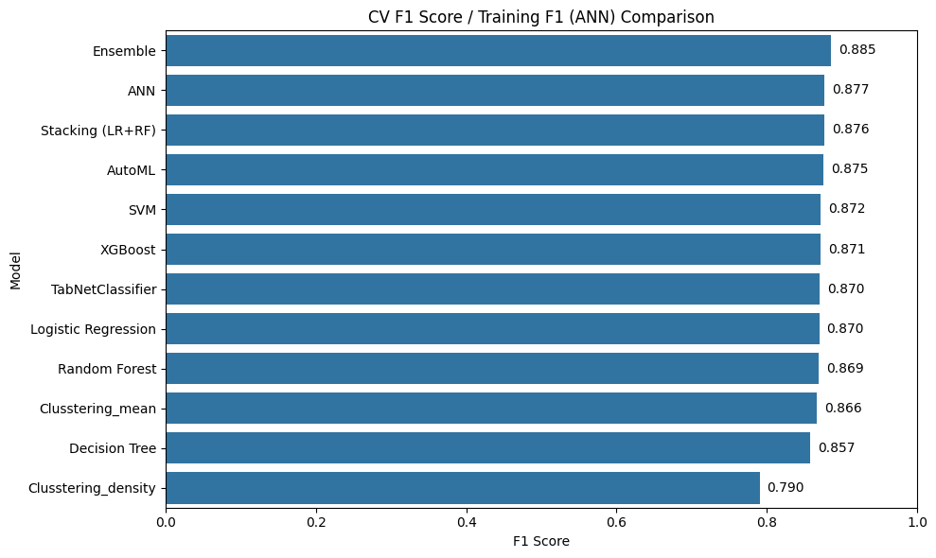
Model Performance Comparison For Train Data

Slide 20
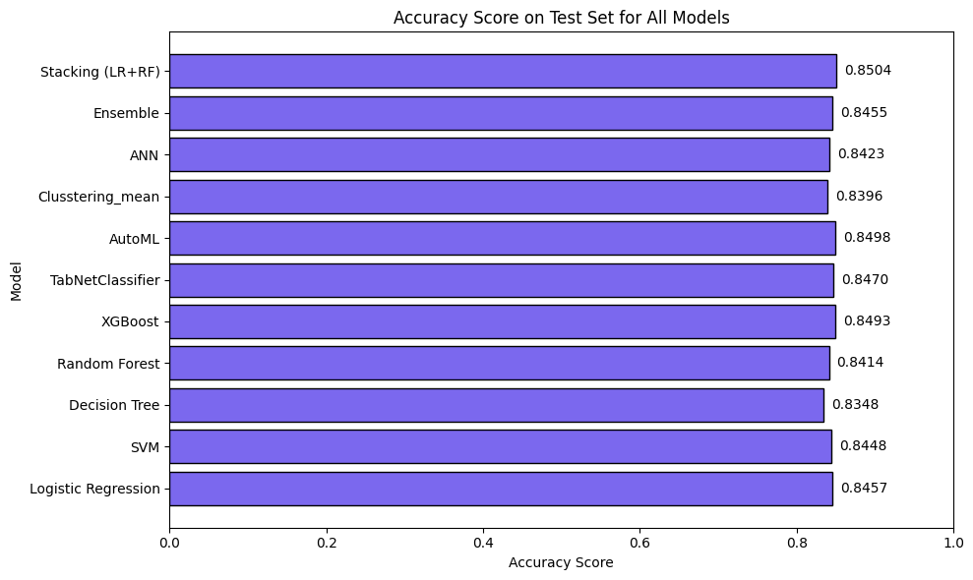
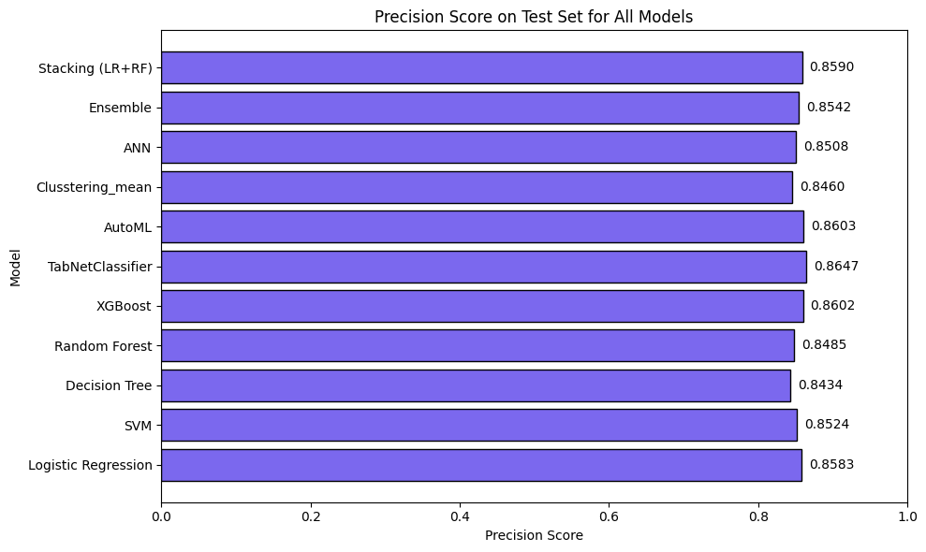
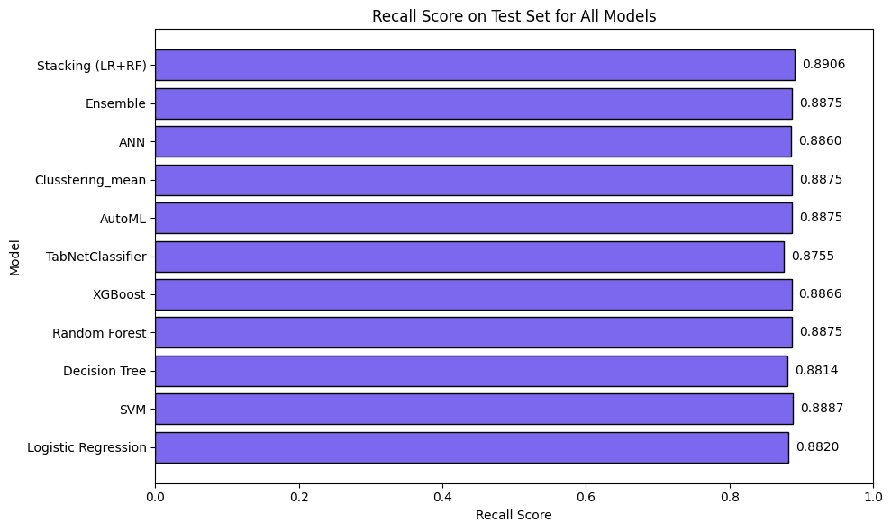
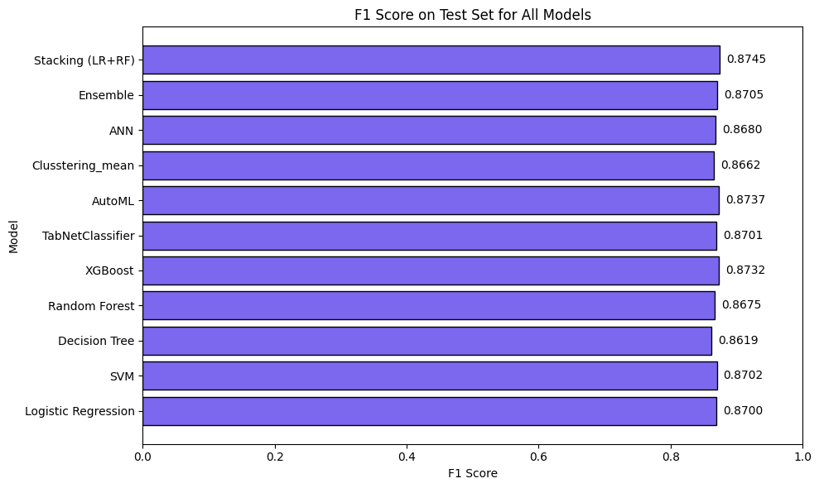
Date:05/05/2025
Model Performance Comparison For Test Data

Slide 21
Date:05/05/2025
Key Findings & Conclusion
Model Performance:
• Stacking ensemble model achieved the best performance (F1: 0.854)
• Tree-based models (Random Forest, XGBoost) performed consistently well
• SHAP analysis revealed suicidal thoughts, academic pressure, and dietary habits as the most important features.
Surprisingly, simple logistic regression performs on par with our best model on some metrics, beating most models.
Svm have very high computation cost but it also gives promising results.
All the tree-based and ensemble models are working good as expected.
We have plotted the evaluation metrics for all the best models but not a single overall best model as, there were few models performing good on training but not so promising on test data.

Slide 22
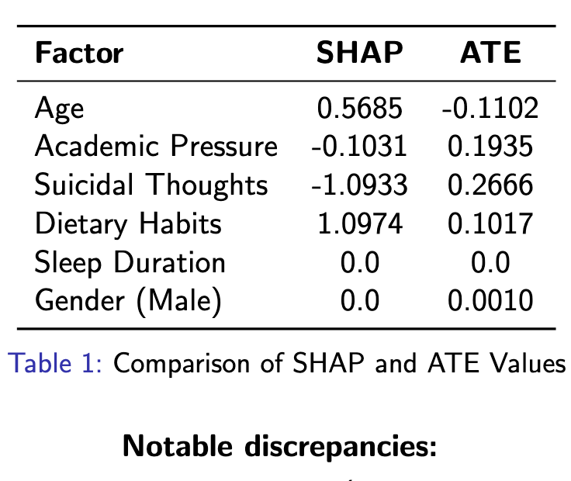
Date:05/05/2025
SHAP vs ATE: Understanding Correlation vs Causation
SHAP Values:
• Reflect feature importance in predictive models
• Based on statistical correlations within dataset
• Show how features influence individual predictions
ATE Values:
• Estimate actual causal impact on depression
• Control for confounding variables
• Provide evidence for intervention design
Key Insight: Predictive importance Causal effect

Slide 23
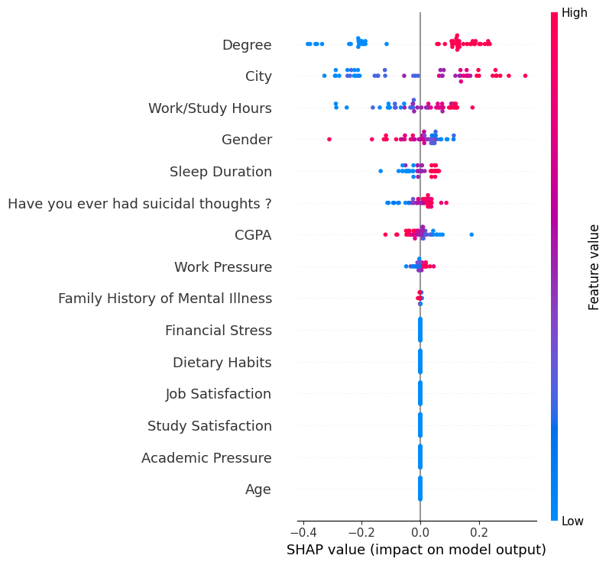
SHAP vs ATE
Here we have the best model’s SHAP values. We can see that important features like Family History, Financial stress, Academic pressure which are known factors which influence depression, but the model isn’t affected by those. The reason why this is happening may be due to the model learning the correlation in data and finding specific patterns in distribution instead of actually representing real causes. It only tells how the model makes the predictions.
This is why it’s not enough to just use shapely or any other feature importance metrics, and we should include some causality analysis when trying to explain the factors behind a phenomenon.

Slide 24
Date:05/05/2025
What Actually Affects Depression?
Having suicidal thoughts emerged as the strongest predictor of depression, contributing the most
to the overall risk.
• Academic pressure is another significant driver, indicating that the stress associated with academic
demands may contribute meaningfully to depressive symptoms.
• Work-study hours show a moderate association with depression, suggesting that excessive work-
load or poor time balance may impact mental well-being.
• Protective factors include age with older individuals showing a reduced likelihood of depression, and
study satisfaction, where higher satisfaction levels are linked with lower risk. These findings point to
the importance of emotional maturity and perceived academic fulfillment in mental health outcomes.
• Some variables, such as sleep duration, CGPA, and gender, demonstrated minimal or no clear
impact on depression in our model. This suggests that these factors are less predictive in this context
or not well captured by the dataset.

Slide 25
Date:05/05/2025
How to Reduce Depression
Evidence-based intervention strategies:
• Academic Pressure:
• Reduce workload
• Enhance support systems
• Educate parents about mental wellbeing
• Suicidal Thoughts:
• Increase access to counseling services
• Early identification through screening
• Study Satisfaction:
• Improve teaching styles
• Increase student engagement
• Hands-on learning approaches
• Work-Study Balance:
• Encourage sports participation
• Promote healthy time management

Slide 26
Date:05/05/2025
Ethical Considerations
Informed Consent
Clear communication about data usage
Option to opt-out without penalty
Data Protection
Robust safeguards against unauthorized access
Anonymization and encryption practices
Differential privacy techniques
Application Guidelines
Avoid misguided interventions based solely on correlations
Balance predictive and causal insights
Privacy-Preserving Machine Learning
Perform differentially private model training to protect user privacy
Support “right to be forgotten” through machine unlearning

Slide 27
Date:05/05/2025
Future Improvements
• Apply differentially private algorithms to create predictive models which ensures privacy of participants, thereby reducing hesitancy in people when it comes to sharing personal info..
• Obtain a much diverse dataset to train on and derive insights.
• Perform indepth multivariate analysis(only single variable has been done) on data to improve explainability and give a deeper insight on which factors affect depression, allowing actionable insights to be derived.
• Apply advanced NN - based algorithms like SAINT, AutoNet, GANDALF, TabTransformer which promises better accuracies compared to traditional tree based models. Also different combinations of ensembling can be experimented

Slide 28
Date:05/05/2025
Real-World Applications
Early Identification: Flag at-risk students before issues escalate.
Improving Student Outcomes: Targeting causal drivers enables more effective mental health interventions in schools.
Policy and Program Development: Data-driven insights guide ethical, tailored mental health policies.
Resource Allocation: Direct resources to most effective interventions.
Outcomes Measurement: Track effectiveness of interventions.
Trust and Transparency: Ensuring consent and data privacy builds long-term stakeholder trust

Slide 29
Date:05/05/2025
Thank You!
Questions?

